Slide 1
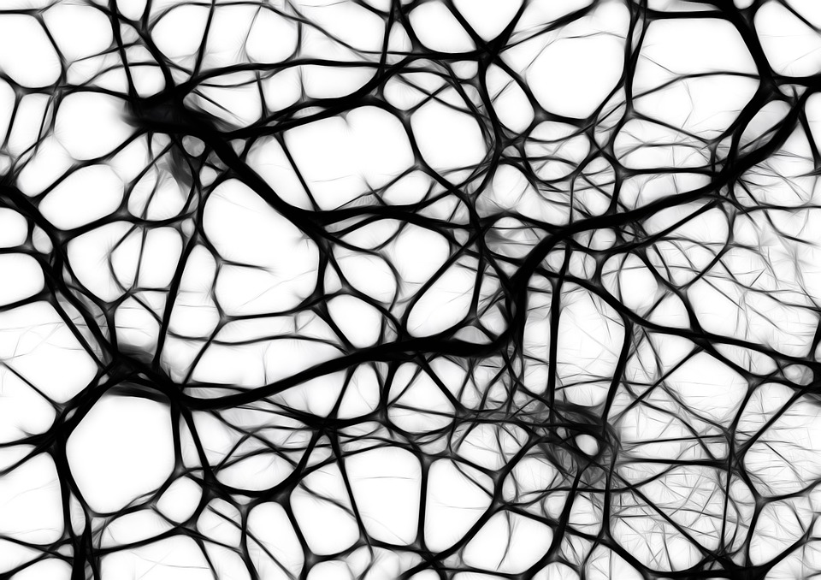
THE ART OF SANTIAGO RAMON Y CAJAL
ARIANA JULIA GAYBAN
PSY763

Slide 2
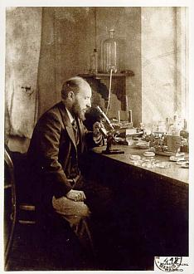
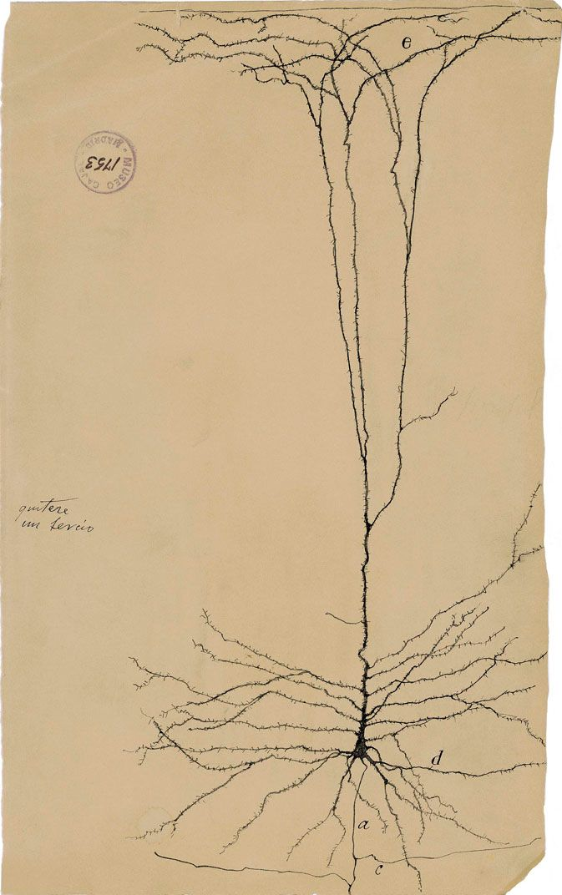

Slide 3
GIANT PYRAMIDAL NEURON OF THE HUMAN CEREBRAL CORTEX (1899)
Ink and pencil on paper
Depicts a giant pyramidal neuron (Betz cell)
Typically host the cell body deep below the cerebral cortex surface with one set of dendrites that can extend to the surface of the brain
Largest neurons in the central nervous system
Typically upper motor neurons and help directly coordinate voluntary movement
Notes:
Betz cells (also known as pyramidal cells of Betz) are giant pyramidal cells (neurons) located within the fifth layer of the grey matter in the primary motor cortex. These neurons are the largest in the central nervous system, sometimes reaching 100 μm in diameter.^{[1][2]}
Betz cells are upper motor neurons that send their axons down to the spinal cord via the corticospinal tract, where in humans they synapse directly with anterior horn cells, which in turn synapse directly with their target muscles. Betz cells are not the sole source of direct connections to those neurons because most of the direct corticomotorneuronal cells are medium or small neurons.^{[3]} While Betz cells have one apical dendrite typical of pyramidal neurons, they have more primary dendritic shafts, which can branch out at almost any point from the soma (cell body).

Slide 4
The axon of the neuron, which carries output signals from the soma
C. The axon also splits into several branches; the longest branch can extend all the way into the spinal cord
D. Depicts the dendrites extending from the soma; receive input communications

Slide 5
E. Set of long apical dendrites extending from the soma that reach the surface of the brain (traverse over 1mm length)
Apical dendrites are characteristic of pyramidal cell types; emerge from the apex
Notes:
An apical dendrite is a dendrite that emerges from the apex of a pyramidal cell.^{[1]} Apical dendrites are one of two primary categories of dendrites, and they distinguish the pyramidal cells from spiny stellate cells in the cortices. Pyramidal cells are found in the prefrontal cortex, the hippocampus, the entorhinal cortex, the olfactory cortex, and other areas.^{[2]} Dendrite arbors formed by apical dendrites are the means by which synaptic inputs into a cell are integrated.^{[3]} The apical dendrites in these regions contribute significantly to memory, learning, and sensory associations by modulating the excitatory and inhibitory signals received by the pyramidal cells.

Slide 6
“The cerebral cortex is similar to a garden filled with innumerable trees, the pyramidal cells, which can multiply their branches thanks to intelligent cultivation, send their roots deeper, and produce more exquisite flowers and fruits every day.”

